Slide 1
Functions

Slide 2
Learning Outcome
Identify user-defined functions and modules.
Create user-defined functions and modules to solve programming problem.

Slide 3

Functions
Group of statements that exist within a program for the purpose of performing a specific task.
Provide better modularity for your application and a high degree of code reusing
print()
input()

Slide 4
Types of Function
Void Functions
Executes the statements it contains and terminates.
Value-Returning Functions
Executes the statements that it contains and returns a value back to the statement that called it.
input()
print()
int()
len()
range()

Slide 5
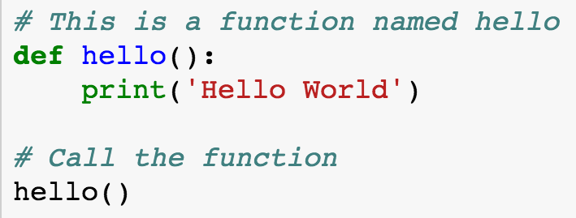
Defining and Calling a Function
These statements define the hello function
This statement calls the hello function

Slide 6
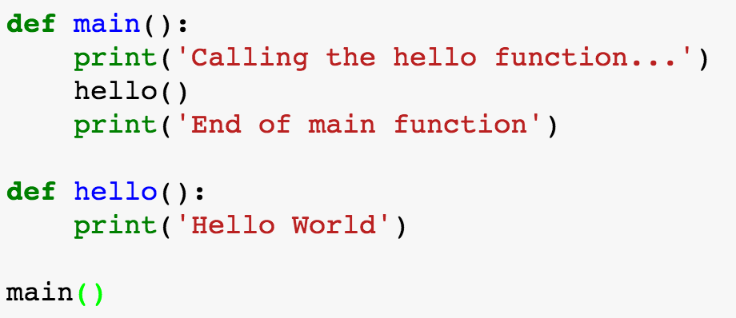
Defining and Calling a Function
First function, main that calls hello() function
hell() function is defined here
Call main() function

Slide 7
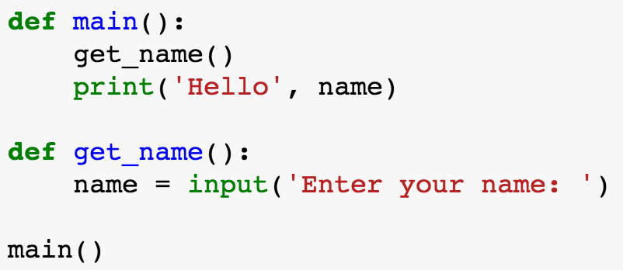
Local variable
What is wrong with this program?

Slide 8
Local variable
A local variable created inside a function can only be accessed by statements inside the function. It cannot be accessed by statments that are outside this function!

Slide 9
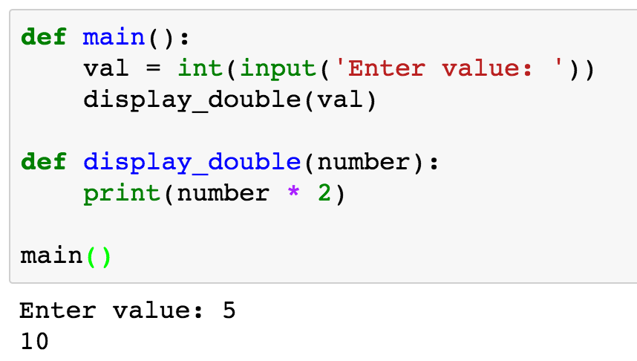
Passing Arguments to Functions
argument
parameter

Slide 10
Argument vs Parameter
Argument
Any piece of data that is passed into a function when the function is called.
Parameter
A variable that receives from an argument that is passed into a function.

Slide 11
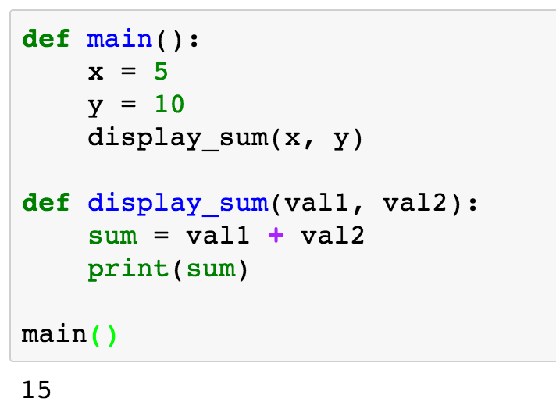
Multiple Arguments Function
2 arguments x and y
2 parameters val1 and val2

Slide 12
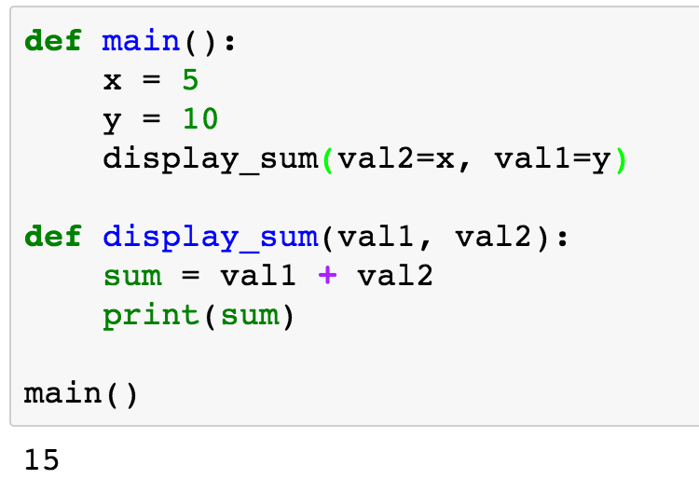
Keyword Arguments
Keyword arguments
2 parameters val1 and val2
You can mix and match keyword and positional arguments, but positional arguments must always come first!

Slide 13
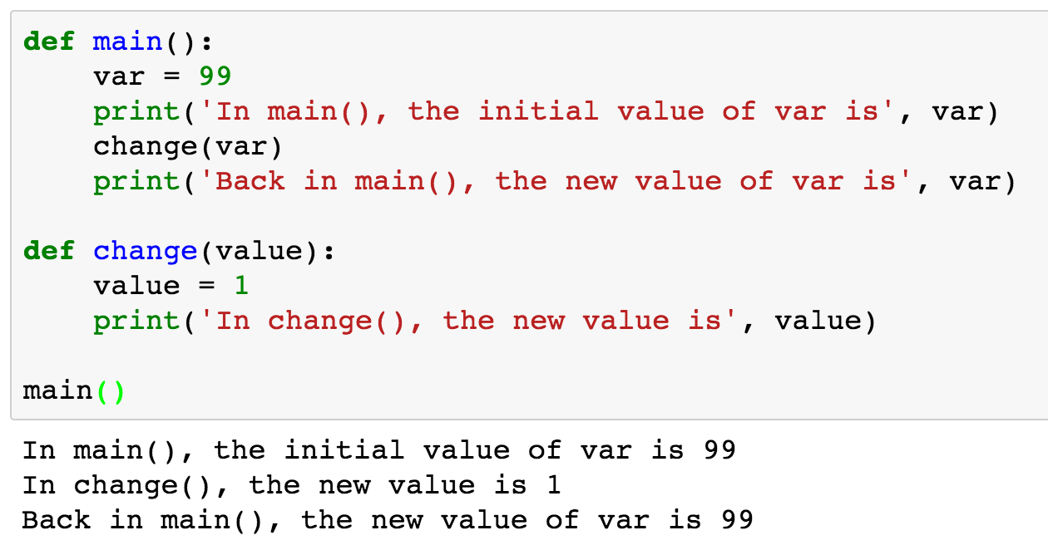
Make changes to Parameter
Value of var remain unchanged?

Slide 14
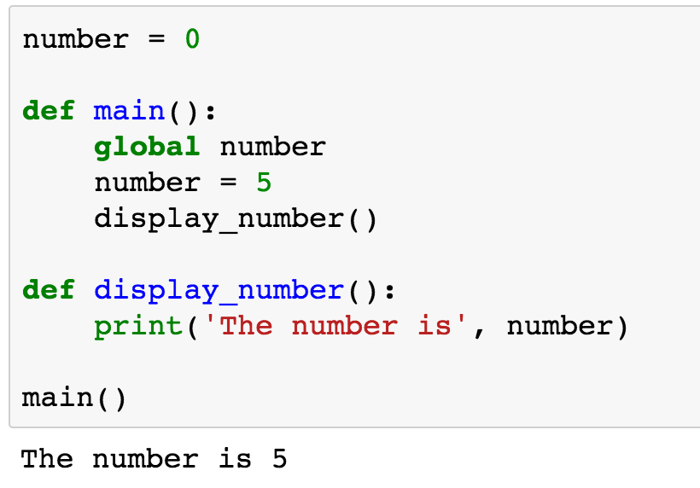
Global vs Local variables
The global keyword in main() function tells the interpreter that the main function intends to assign a value to the global variable, number.
⚠

Slide 15
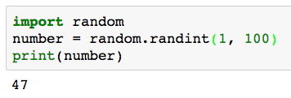
Value Returning Function
module name → random
function name → randint()
arguments → 1, 100
return type → int

Slide 16
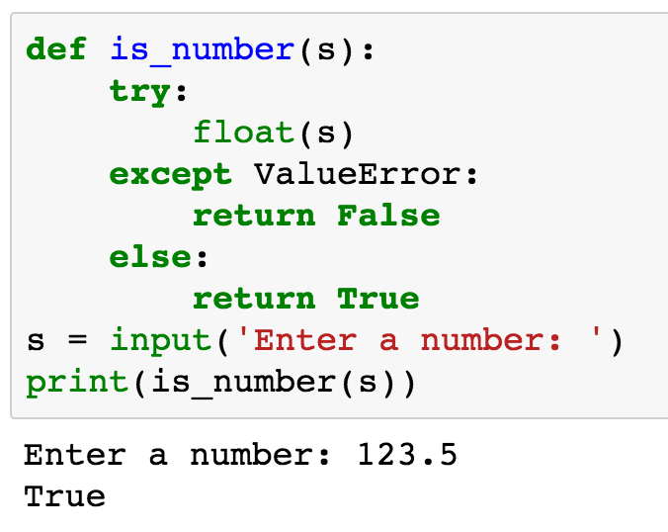
Value Returning Function
function → is_number()
arguments → string (s)
return type → boolean

Slide 17
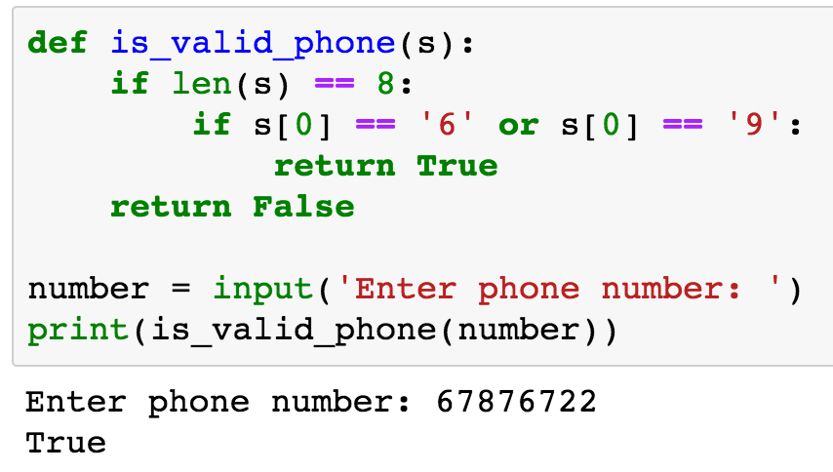
Value Returning Function
function →is_valid_phone()
arguments → string (s)
return type → boolean

Slide 18
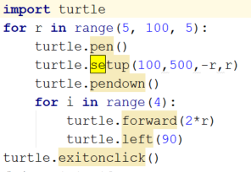
Modules
A file consisting of Python code.
Can define functions, classes and variables.
Can also include runnable code.
Abstraction
Use import keyword
Easier to understand and use

Slide 19
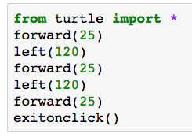
Modules
Python’s from statement lets you import all names from a module into the namespace
An easy way to import all the items from a module into the current namespace. ⚠⚠⚠
from <module> import *

Slide 20
Locating Modules
When you import a module, the Python interpreter searches for the module in the following sequences:
The current directory
The directory in the shell variable PYTHONPATH
The default path where Python is installed

Slide 21
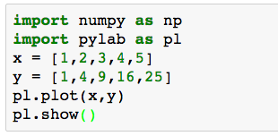
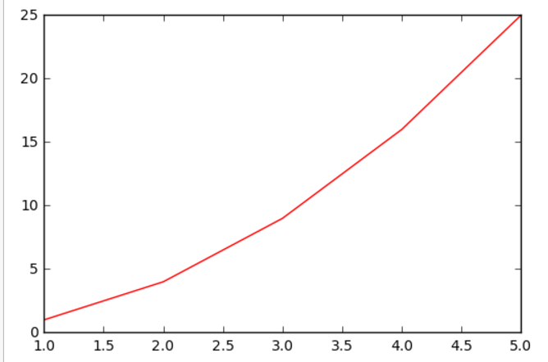
Numpy and Matplotlib Module
Numpy - this is the module which does most array and mathematical manipulation
Matplotlib - this is the module used for plotting

Slide 22
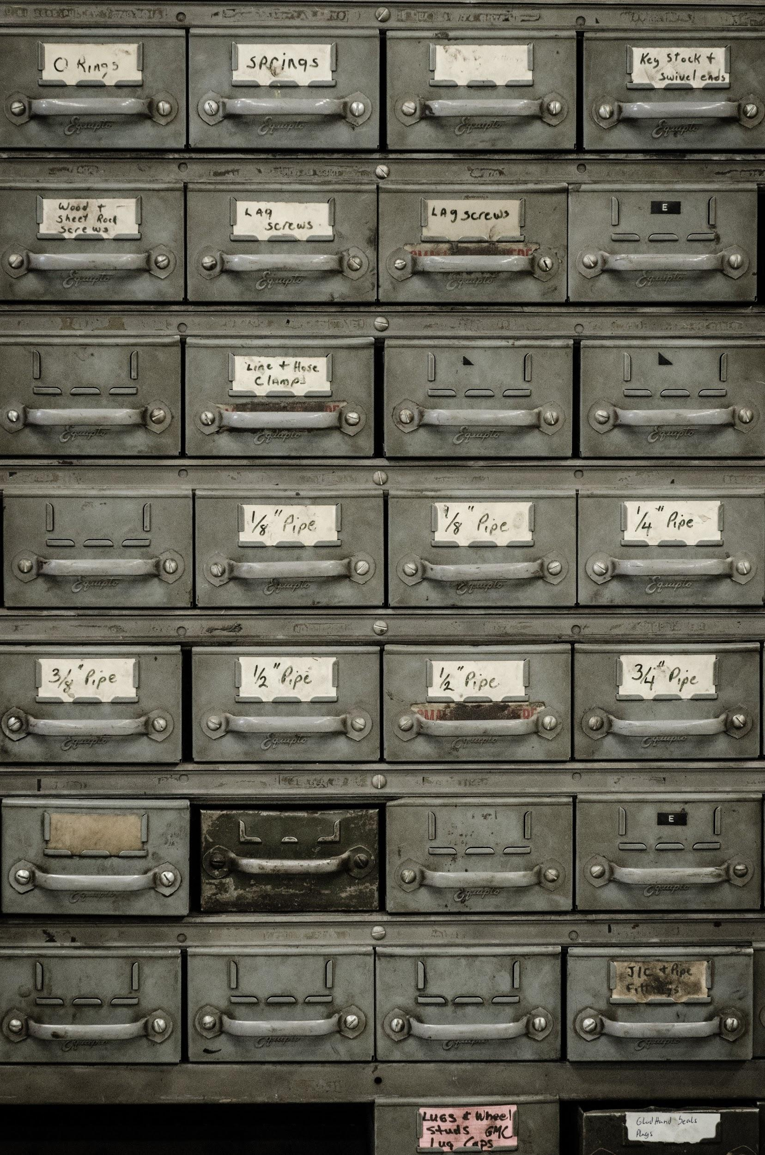
Create your own Module
Maintainability
Organize your code into different modules make it easier for you to maintain it. Make changes only at one location.
Reusability
With modules, you could reuse functions across different project.

Slide 23
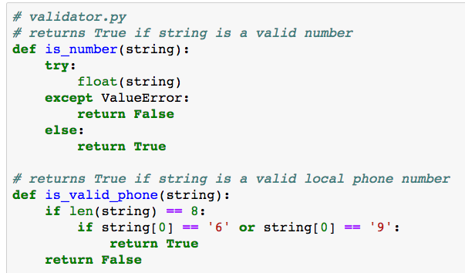
Create your own Module

Slide 24
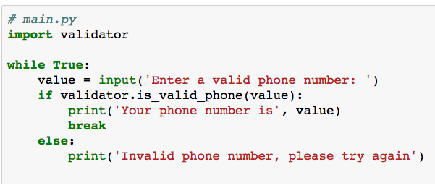
Using Module

Slide 25
Using your module
import validator
import validator
value = input('Enter a valid number: ')
if validator.is_number(value):
print('Valid number!')
import validator as val
import validator as va
value = input('Enter a valid number: ')
if va.is_number(value):
print('Valid number!')

Slide 26
Summary
Identify user-defined functions and modules.
Create user-defined functions and modules to solve programming problem.

Slide 27
Write a python function to find the Max of three numbers
Max_three

